Slide 1
Digital Portfolio
STUDENT NAME: SHEERIN RAXSANA.B
REGISTER NO AND NMID: 9568EA2282F44AB9C334625B03014E57
DEPARTMENT: BSC COMPUTER SCIENCE
COLLEGE: COLLEGE/ UNIVERSITY: TIRUPPUR KUMARAN COLLEGE FOR WOMEN/BARATHIYAR UNIVERSITY

Slide 2

PROJECT TITLE

Slide 3


AGENDA
Problem Statement
Project Overview
End Users
Tools and Technologies
Portfolio design and Layout
Features and Functionality
Results and Screenshots
Conclusion
Github Link
3/21/2024 Annual Review

Slide 4

PROBLEM STATEMENT
The rapid advancement of digital technologies is shaping the future of industries, societies, and individuals. Professionals, innovators, and students working in technology need a strong personal brand to showcase their skills, projects, and vision. However, many struggle to present their work in a modern, engaging, and interactive format.

Slide 5

PROJECT OVERVIEW
The “Shaping the Future of Technology” Portfolio Website is a personal web-based application developed using HTML, CSS, and JavaScript. It is designed to showcase an individual’s skills, vision, and projects in the field of technology through a modern, interactive, and responsive interface.

Slide 6

WHO ARE THE END USERS?
The end users of the “Shaping the Future of Technology” Portfolio Website are: Students & Professionals – to showcase their skills, projects, and vision in technology. Recruiters & Employers – to evaluate candidates’ technical expertise and creativity. General Audience & Tech Enthusiasts – to explore innovative and futuristic tech solutions.

Slide 7

TOOLS AND TECHNIQUES
The project was developed using HTML5 for structure, CSS3 for styling and responsive design, and JavaScript for interactivity and form handling. Development was done in VS Code, and testing was carried out in modern web browsers. Techniques applied include responsive web design (using Flexbox and Grid), smooth scrolling, hover effects with transitions, and basic form validation to enhance user experience.

Slide 8
POTFOLIO DESIGN AND LAYOUT
The portfolio is designed with a fixed navigation bar, a hero section with title and call-to-action, an About section for introduction, a Projects section with grid cards, a Contact form for communication, and a Footer for branding — all styled in a modern, responsive, and futuristic layout.
8

Slide 9
FEATURES AND FUNCTIONALITY
The portfolio features a responsive design with a fixed navigation bar and a futuristic hero section. It includes an About section, a Projects showcase with hover effects, and a Contact form with validation. Interactive elements like smooth scrolling, transitions, and footer branding enhance user experience.

Slide 10
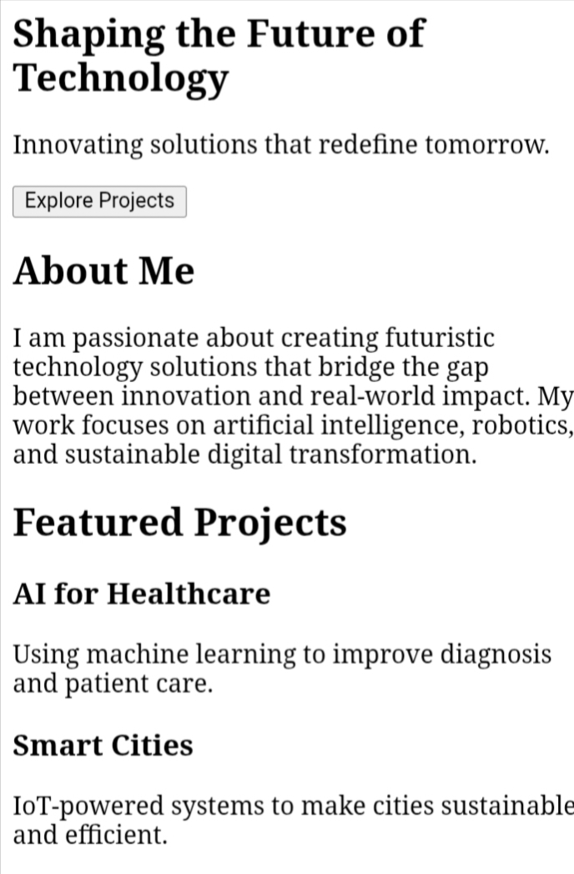
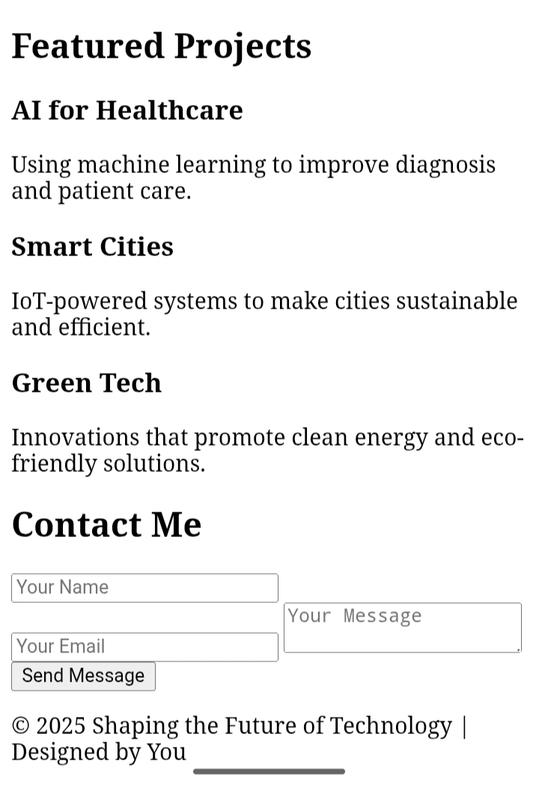

RESULTS AND SCREENSHOTS
3/21/2024 Annual Review
10

Slide 11
CONCLUSION
The “Shaping the Future of Technology” Portfolio Website successfully demonstrates the use of HTML, CSS, and JavaScript to build a modern, responsive, and interactive personal portfolio. It provides an effective platform to showcase skills, projects, and vision, while ensuring a user-friendly and engaging experience. This project highlights how simple front-end technologies can create a professional digital identity for students and professionals in the tech domain.
11

